Slide 2
Campus Recreation
Pottruck Health & Fitness Center
Weight & Cardio Equipment
Olympic Size Indoor Pool
40-foot Climbing Wall
Locker Room and Shower Facilities
Fox Fitness Center
219 South 33rd Street
Two Floors of Weight and Cardio Equipment

Slide 3
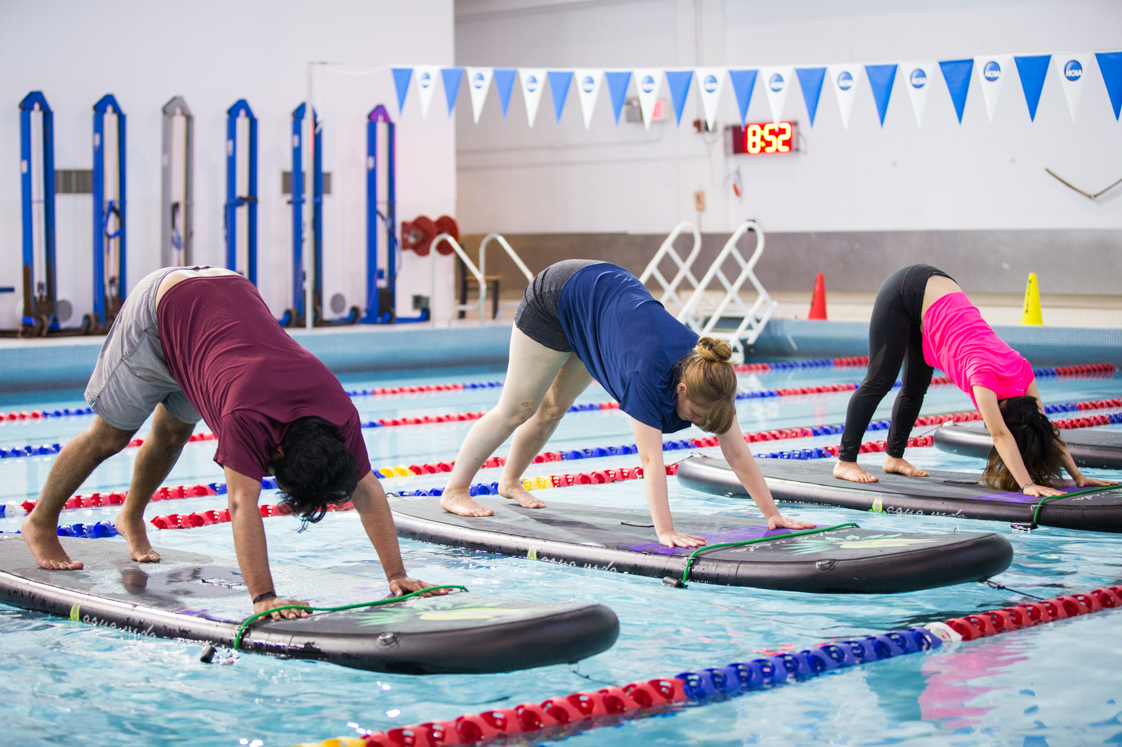
Programs & Services
30+ Sport Clubs
Lap Swim & Lessons
Red Cross & Scuba Certifications
Massage Therapy
Pilates
Premium Fitness
Outdoor Gear Rentals

Slide 4
Virtual Programs
Group Exercise
Personal Training
E-sports
www.recreation.upenn.edu/remotehub

Slide 5
Contact Us
recreation.upenn.edu
DRIA-pennrec@pobox.upenn.edu
(215) 898-6100

